Slide 1
PROFESSIONAL TRAINING 1 DECEMBER 2021 SCHOOL OF ELECTRICAL & ELECTRONICS SATHYABAMA INSTITUTE OF SCIENCE & TECHNOLOGY
NAME: RUTH BALAJI
REG.NO: 39130382
SECTION: B1
DEPARTMENT: ECE
BATCH: 2019-2023

Slide 2
PERSON COUNT DETECTION TO KEEP EVERYONE SAFE DURING PANDEMIC USING EMBEDDED SYSTEM
BY:
RUTH BALAJI (39130382)
SUBHARAJA CHELLAM.A (39130443)

Slide 3
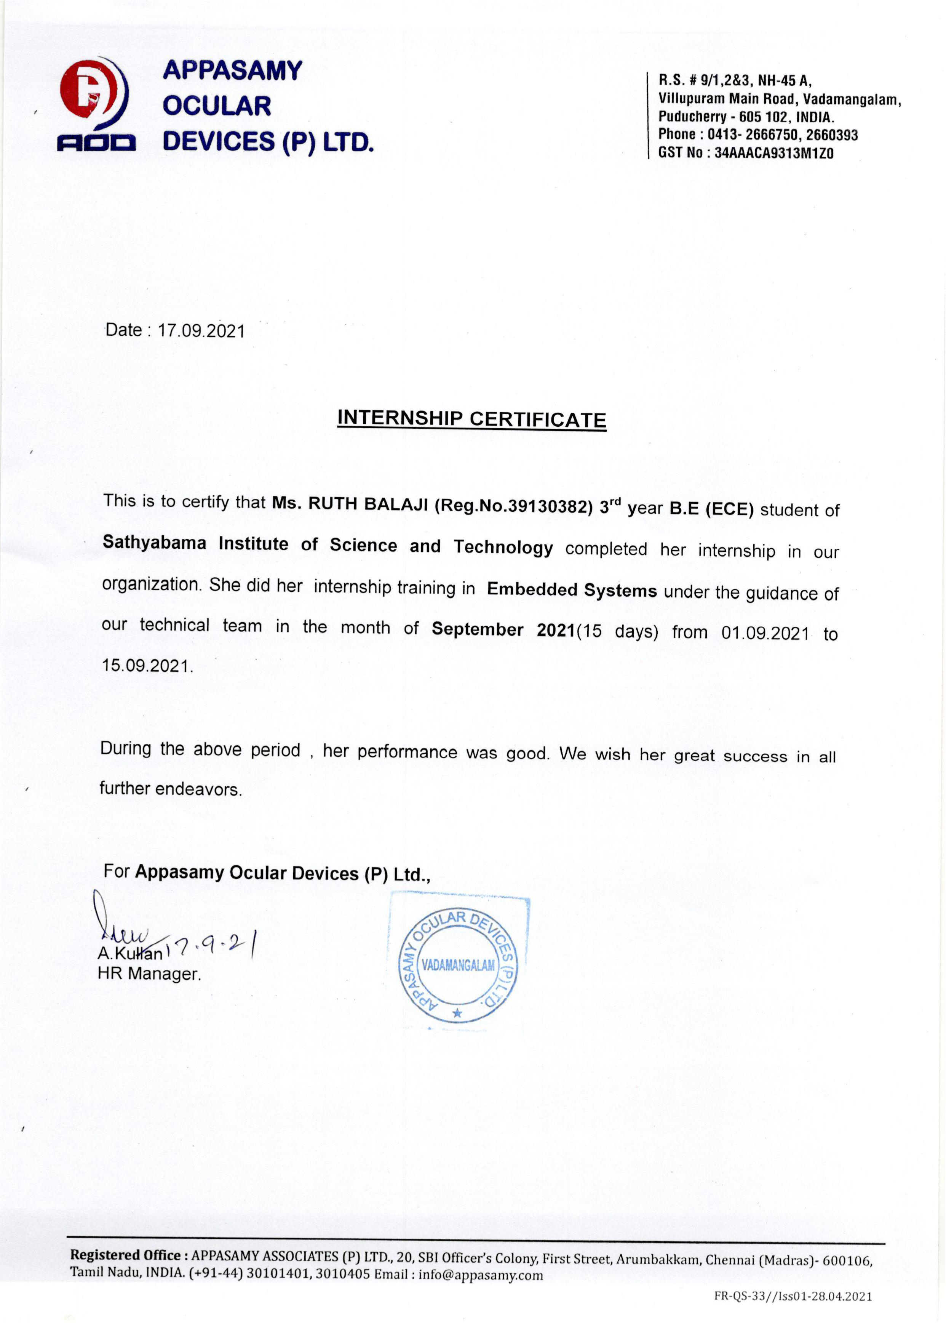

Slide 4


Slide 5
OVERVIEW
ABATRACT
OBJECTIVE
PROBLEM DEFINITION
COMPONENTS
PROGRAMMING LANGUAGE
BLOCK DIAGRAM
DESCRIPTION ABOUT EACH COMPONENT
WORKING
CONCLUSION
REFERENCES

Slide 6
ABSTRACT
According to the data obtained by the World Health Organization, the global pandemic of COVID-19 has severely impacted the world and has now infected more than eight million people worldwide.
The rise of COVID-19 pandemic has had a lasting impact in many countries worldwide since 2019.
The proposed approach in this project is developed to avoid more people from entering the desired places (i.e., Mall, University, Office.. etc) by detecting people count using Arduino and Sensors to count the number of people while entering and exiting.
This helps to maintain the social distancing inside those places and limit the total number of persons.
If the total number of people count increased, the Arduino microcontroller will give the buzzer alarm to notify the person.

Slide 7
OBJECTIVE
According to data obtained by the World Health Organization, the global pandemic of COVID-19 has severely impacted the world and has now infected more than eight million people worldwide.
So in order to reduce the spread of the virus this project is designed to maintain social distance by constraining the entry of people in desired places (i.e., Mall, Schools, Offices, University…etc)

Slide 8
PROBLEM DEFINITION
The proposed approach in this project is developed to avoid more people from entering the desired places (i.e., Mall, University, Office.. Etc) by detecting people count using Arduino.

Slide 9
COMPONENTS
HARDWARE:
*Arduino Nano
*IR Sensor
*Liquid Crystal Display Base
*Liquid Crystal Display
*Buzzer
*Cable
* Connecting wire
SOFTWARE:
* Arduino IDE

Slide 10
PROGRAMMING LANGUAGE
EMBEDDED C- LANGUAGE:
* It is an extension to the traditional C programming language, that is used in embedded systems. The embedded C programming language uses the same syntax and semantics as the C programming language.
* The only extension in the Embedded C language from normal C Programming Language is the I/O Hardware Addressing, fixed-point arithmetic operations, accessing address spaces, etc.

Slide 11
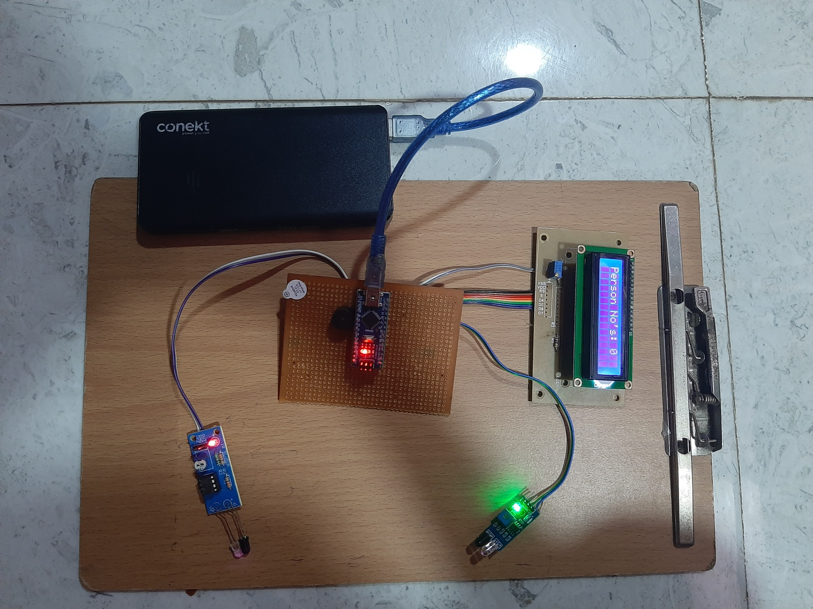

Slide 12
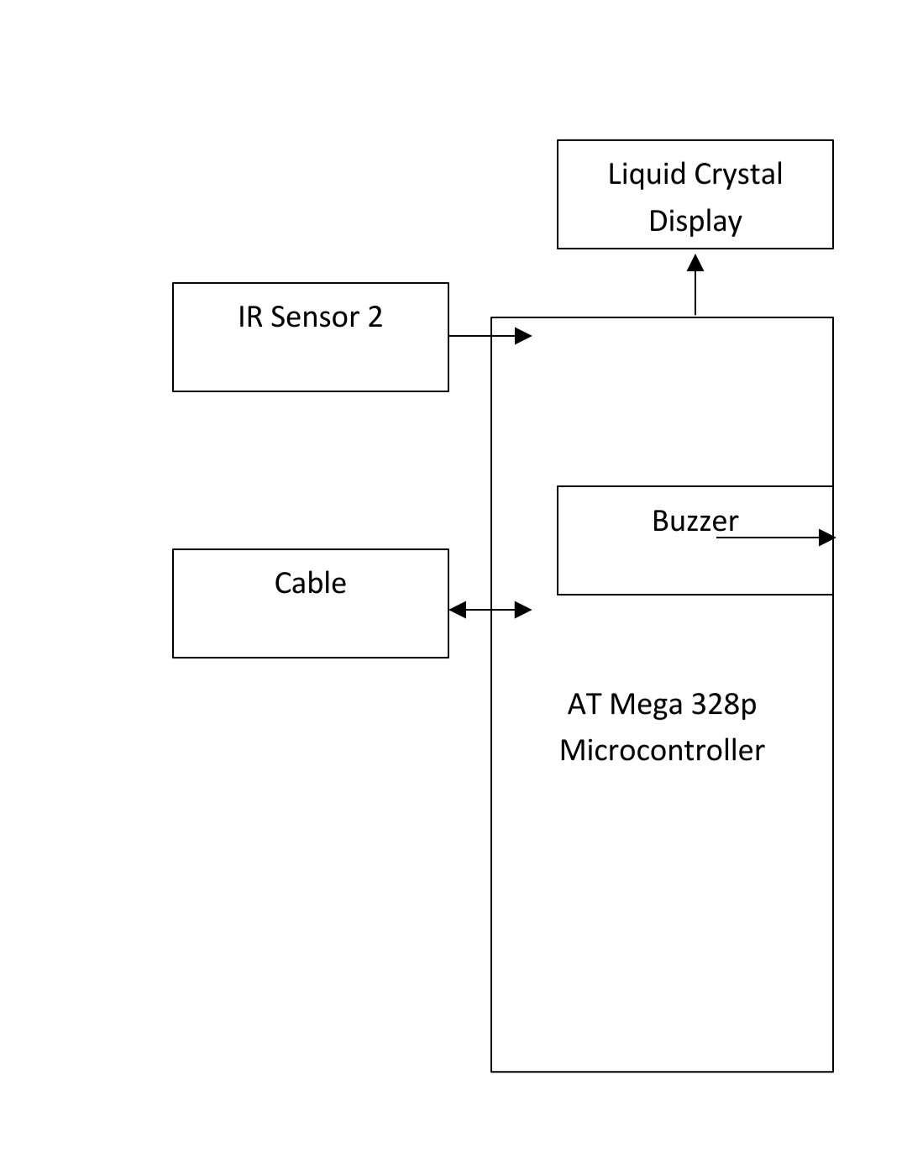
BLOCK DIAGRAM

Slide 13
ARDUINO
Arduino is a single-board microcontroller used to make electronics in multidisciplinary project more accessible.
The hardware consists of a simple open source hardware board designed around 8-bits Atmel AVR microcontroller or a 32-bit Atmel ARM.
The software consists of standard programming language compiler and a boot loader that executes on the microcontroller.

Slide 14
ARDUINO NANO
The Arduino Nano is a small, complete and breadboard-friendly board based on the ATmega328.
It has more or less the same functionality of the Arduino Duemilanove, but in a different package.
It comes with a crystal oscillator of frequency 16MHz.
It is used to produce a clock of precise frequency using constant voltage.
One limitation of using Arduino Nano is that it doesn’t come with a DC power jack, which means you can not supply an external power source through a battery.

Slide 15
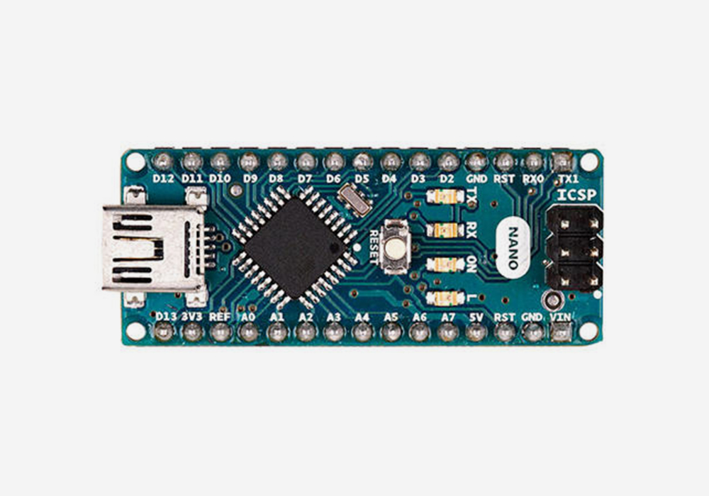

Slide 16
IR SENSOR
An infrared sensor (IR sensor) is a radiation-sensitive optoelectronic component with a spectral sensitivity in the infrared wavelength range 780 nm … 50 µm.
IR sensors are now widely used in motion detectors, which are used in building services to switch on lamps or in alarm systems to detect unwelcome guests.
There are two types of infrared sensors: active and passive. *Active infrared sensors both emit and detect infrared radiation. Active IR sensors have two parts: a light emitting diode (LED) and a receiver. When an object comes close to the sensor, the infrared light from the LED reflects off of the object and is detected by the receiver. Active IR sensors act as proximity sensor, and they are commonly used in obstacle detection systems (such as in robots).
Passive infrared (PIR) sensors only detect infrared radiation and do not emit it from an LED. Passive infrared sensors are comprised of:
Two strips of pyroelectric material (a pyroelectric sensor)
An infrared filter (that blocks out all other wavelengths of light)
A Fresnel lens (which collects light from many angles into a single point)
A housing unit (to protect the sensor from other environmental variables, such as humidity)

Slide 17
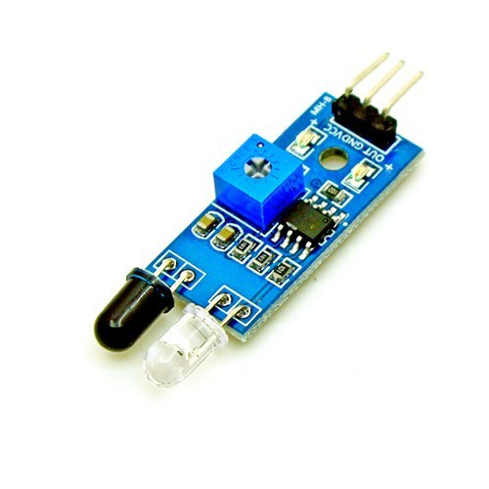

Slide 18
LIQUID CRYSTAL DISPLAY
A liquid-crystal display (LCD) is a flat-panel display or other electronically modulated optical device that uses the light-modulating properties of liquid crystals combined with polarizer's. Liquid crystals do not emit light directly, instead using a backlight or reflector to produce images in color or monochrome.
It has materials which combine the properties of both liquids and crystals. Rather than having a melting point, they have a temperature range within which the molecules are almost as mobile as they would be in a liquid, but are grouped together in an ordered form similar to a crystal.
An LCD consists of two glass panels, with the liquid crystal material sand witched in between them. The inner surface of the glass plates are coated with transparent electrodes which define the character, symbols or patterns to be displayed polymeric layers are present in between the electrodes and the liquid crystal, which makes the liquid crystal molecules to maintain a defined orientation angle.

Slide 19
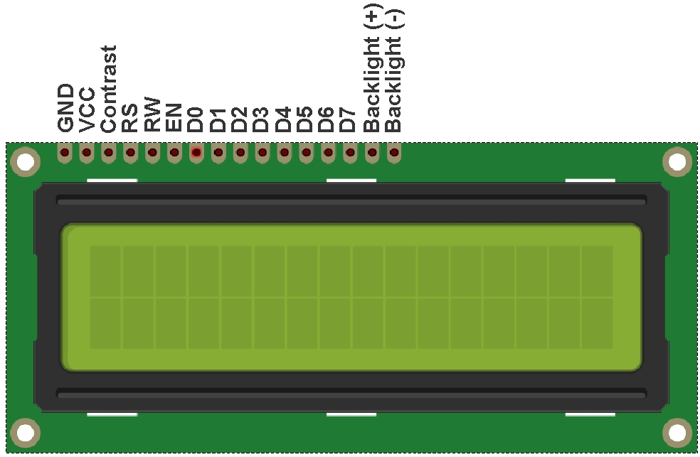

Slide 20
BUZZER
A buzzer or beeper is an audio signaling device which may be mechanical, electromechanical or piezoelectric.
Typical uses of buzzer or beeper include alarm device, timers and confirmation of user input such as a mouse click or keystroke.
Buzzer is an integrated structure of electronic transducers, DC power supply, widely used in computers, printers, copiers, alarms, electronic toys, automotive electronic equipment, telephone.
Active buzzer 5V rated power can be directly connected to a continuous sound.

Slide 21
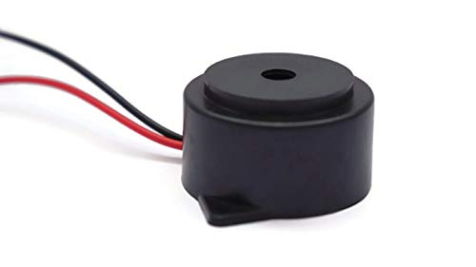

Slide 22
CABLE
Power cable types are power cord, extension cable, twisted, shielded, extensible, communication cable, and many more.
These cables can be used overhead or buried underground.
Types of Computer Cables: Types of computer cables are power cable and data cable.
A cable should have the following three components,
1.Conductor: The conducting part is used to transmit electricity. Extensively used conductors are copper and aluminum.
2.Insulator: To keep the conductors separated from each other and prevent unintended paths for current flow (e.g. short circuit), the wires are shielded with insulating materials. Various synthetic polymers are used for this purpose.
3.Sheath: It is yet another layer to give protection to the wires from chemical reactions with the atmosphere. A common material for the sheath is PVC (polyvinyl chloride).

Slide 23
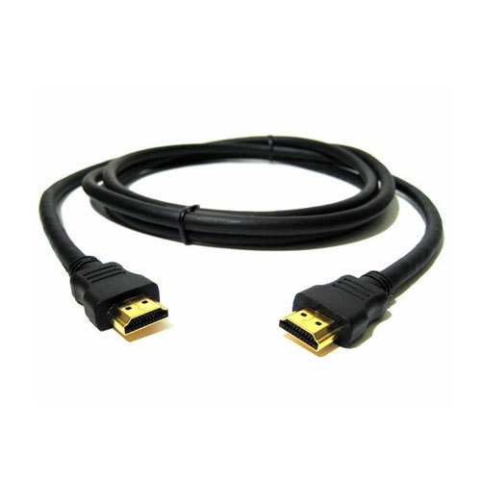

Slide 24
CONNECTING WIRES
Wires are used for establishing electrical conductivity between two devices of an electrical circuit.
Connecting wires allows an electrical current to travel from one point on a circuit to another because electricity needs a medium through which it can move.
Most of the connecting wires are made up of copper or aluminum.

Slide 25
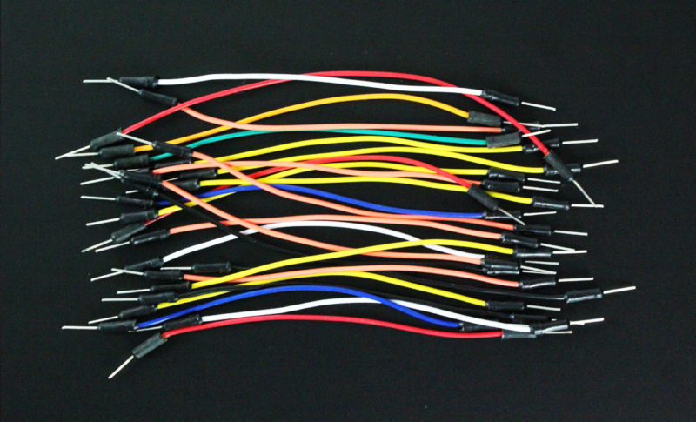

Slide 26
ARDUINO IDE
The Arduino Integrated Development Environment or Arduino Software (IDE) contains a text editor for writing code, a message area, a text console, a toolbar with buttons for common functions and a series of menus.
It connects to the Arduino hardware to upload programs and communicate with them.

Slide 27
WORKING
In this project the arduino microcontroller has been programmed in such a way to detect the number of people entering a desired place.
There are two IR sensors in which are for the input and the other is for output.
A buzzer is present.
The Liquid Crystal Display, displays the people count of entry and exit.
When a person enters , the Input IR senor senses the number of people entering inside a desired place (Super markets, classrooms etc.).
Once the maximum number of people count is reached then the buzzer begins to beep denoting the “ please wait, Not allowed” in LCD display.
When a person is standing near the IR sensor input then another person inside the desired place ( Super market, classroom etc.) cannot exit.
Only when the person moves away from the IR sensor input , the person inside can exit.
The IR sensor output detects the number of people exiting from the desired place and then allows the people to enter the place.
When the IR sensor detects the people count it gets displayed on the LCD display.

Slide 28
CONCLUSION
This project is very helpful in the most crucial times due to the COVID-19.
It helps in making sure that social distance is maintained and places are not crowded avoiding the spread of the virus.
The IR sensor used makes sure that the number of people allowed in and out are restricted correctly to number of people inputted in.

Slide 29
REFERENCES
Carvalho, Bruno & Silva, Caio & Silva, Alessandra & Buiati,Fábio & de Sousa Junior, Rafael. (2016). Evaluation of an Arduino-based IoT Person Counter. 129-136.10.5220/0005954601290136.
J. W. Choi, X. Quan and S. H. Cho, "Bi-Directional Passing People Counting System Based on IR-UWB Radar Sensors,"in IEEE Internet of Things Journal, vol. 5, no. 2, pp. 512-522,April 2018, doi: 10.1109/JIOT.2017.2714181.
Jothibasu M, Aakash B, Shanju Ebanesh K, Gokul Vinayak L,“Automatic Room Monitoring with Visitor Counter (ARM –VC)”, IJITEE, Volume-8 Issue-7, May, 2019
Jingwen Li, Lei Huang and Changping Liu, "An efficient self-learning people counting system," The First Asian Conference on Pattern Recognition, Beijing, 2011, pp. 125-129, doi:10.1109/ACPR.2011.6166686.
K. Madhira and A. Shukla, "Pedestrian flow counter using image processing," 2017 International Conference on Energy,Communication, Data Analytics and Soft Computing (ICECDS),Chennai, 2017, pp. 1911-1915, doi:10.1109/ICECDS.2017.8389782

Slide 30
P.A. Balland, C. Jara-Figueroa, S.G. Petralia, M.P. Steijn, D.L.Rigby, C.A. Hidalgo. Complex economic activities concentrate in large cities. Nature Human Behavior. 2020 Jan 13:1-7.
S.T. Hassan, M.A. Baloch, N. Mahmood, J. Zhang. Linking economic growth and ecological footprint through human capital and biocapacity. Sustainable Cities and Society. 2019 May 1;47:101516.
M. Sathishkumar, S. Rajini. Smart surveillance system using pir sensor network and gsm. International Journal of Advnced Research in Computer Engineering & Technology. 2015 Jan;4(1).

Slide 31
THANK YOU☺

